Slide 1
Case Study - 2
Sai Sreeja Mukka

Slide 2
Mandatory Case - 1
Data pipeline for performing Data conversions and performing aggregation operations
Create a spark Job that reads CSV from AWS S3 (Host the downloaded CSV file in AWS s3) and write the entire set of records in to table in Keyspace
Create another Spark Job to read the data from Keyspace and store the data into another AWS bucket in the form of Parquet
Create Multiple Spark Jobs that perform aggregation operations the data set that is in parquet format on various columns that is present in the dataset

Slide 3
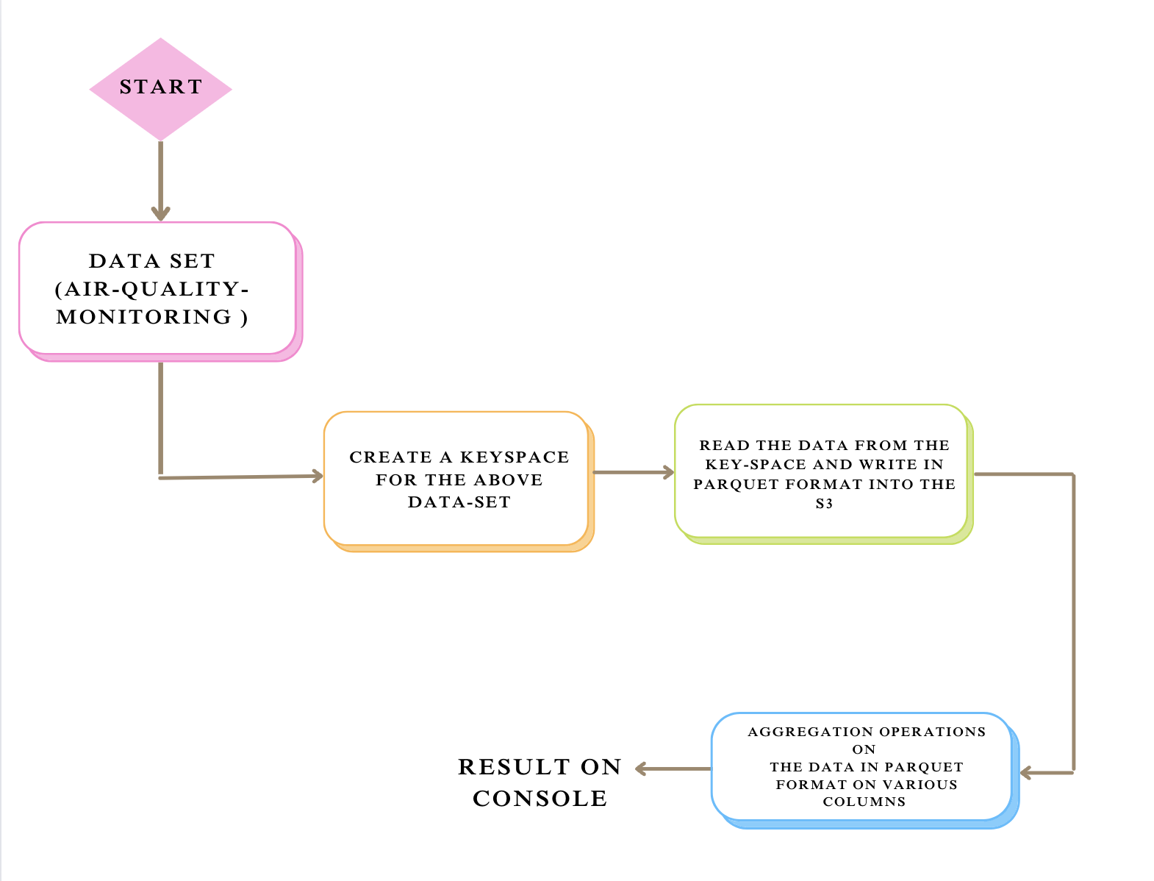
Flow Diagram

Slide 4
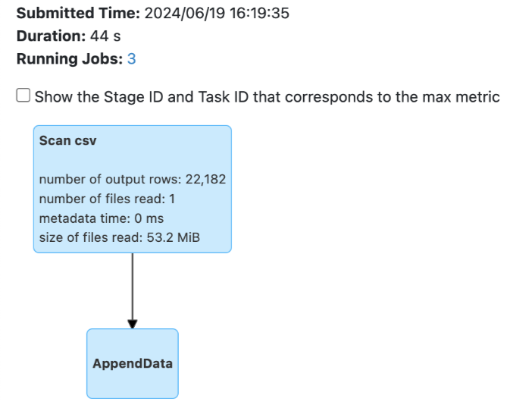
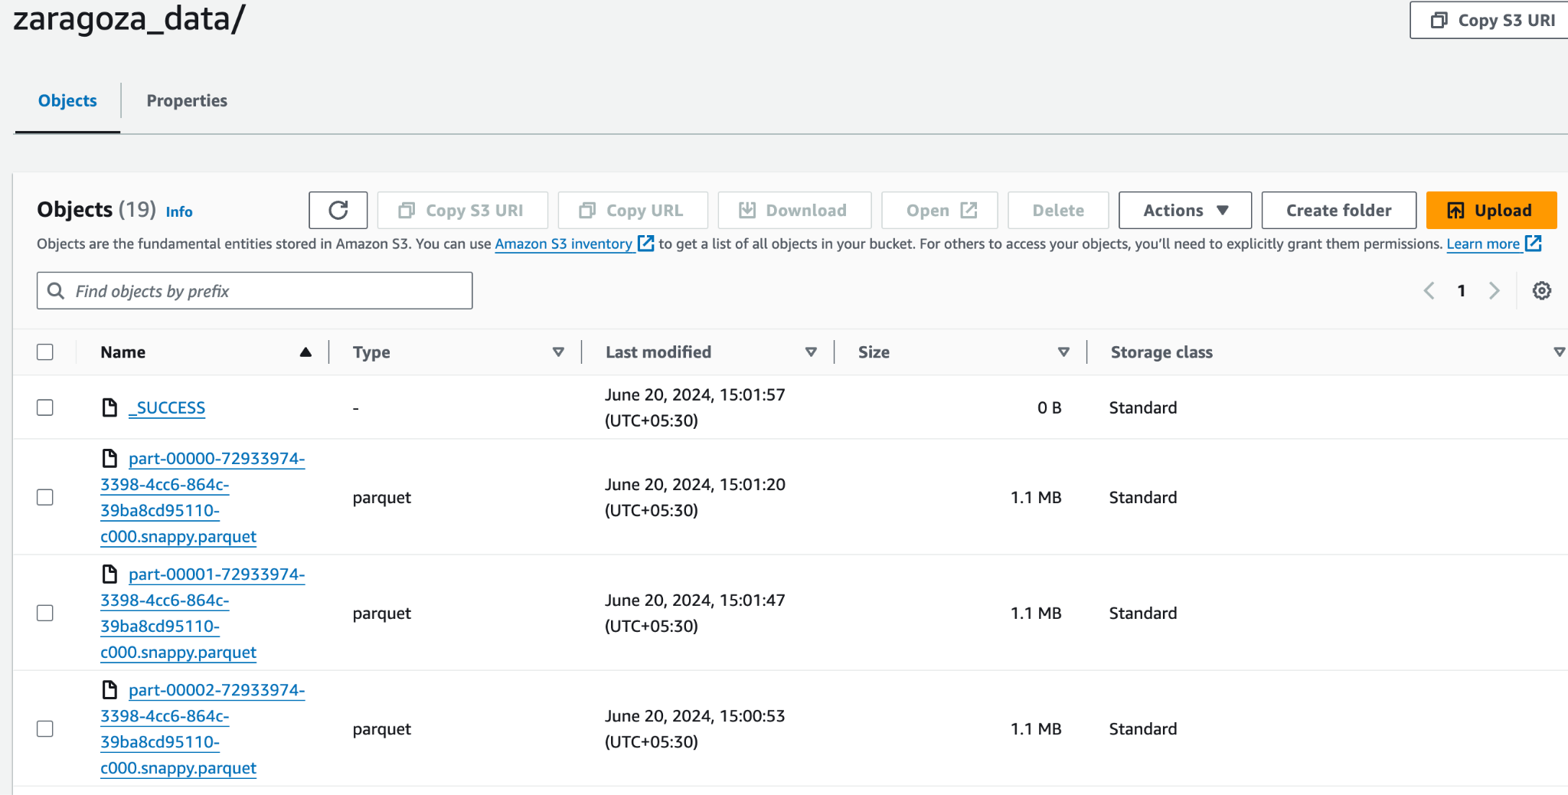
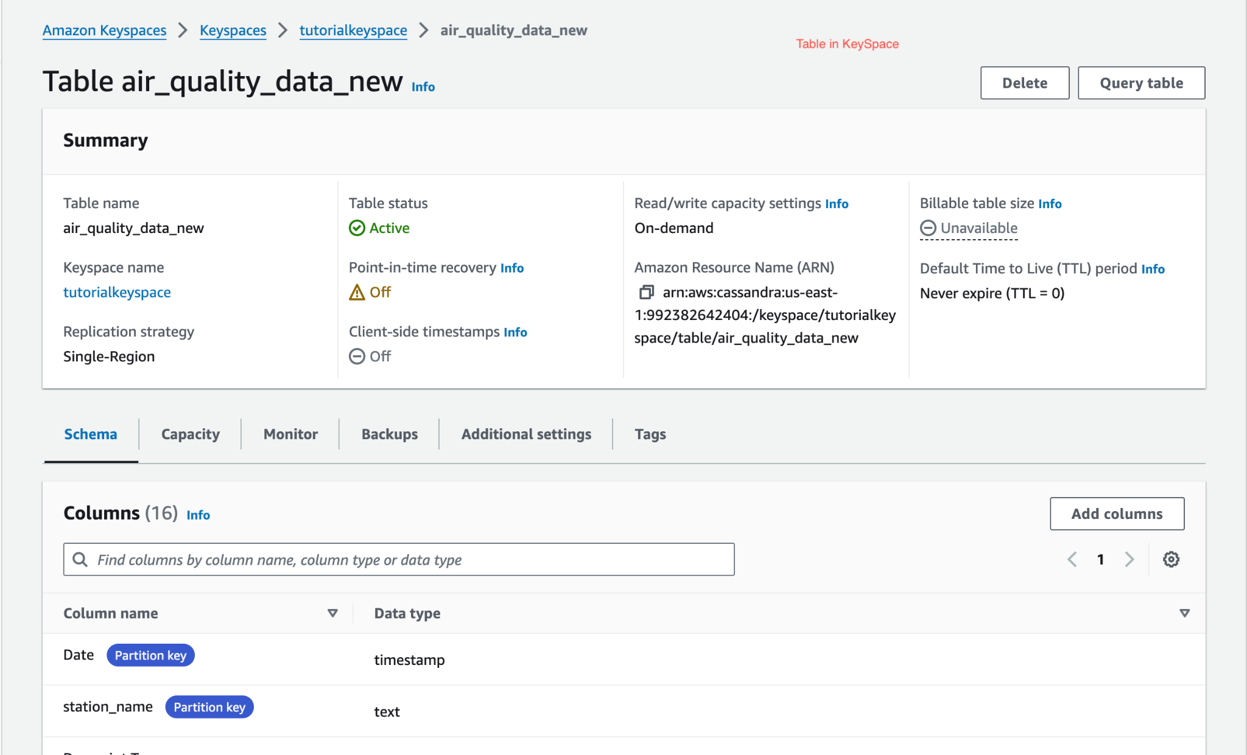
Mandatory Case - 1

Slide 5
Mandatory Case - 2
Streaming Job using Kafka , Spark and Protobuf
Develop a AKKA microservice to generate a JSON structure representing server metrics data.
Create Spark Streaming Job that reads the topic and Convert the JSON to Binary using protobuf serialization and write the messages to another Kafka Topic.
Create another Spark Streaming Job that read the topic and convert the protobuf serialized binary data into csv data append into separate files based on the metric type ( For each metric maintain a separate CSV file.
Create few Spark Jobs Each job performing and Aggregation operation on the CSV files and write the results in a CSV file

Slide 6
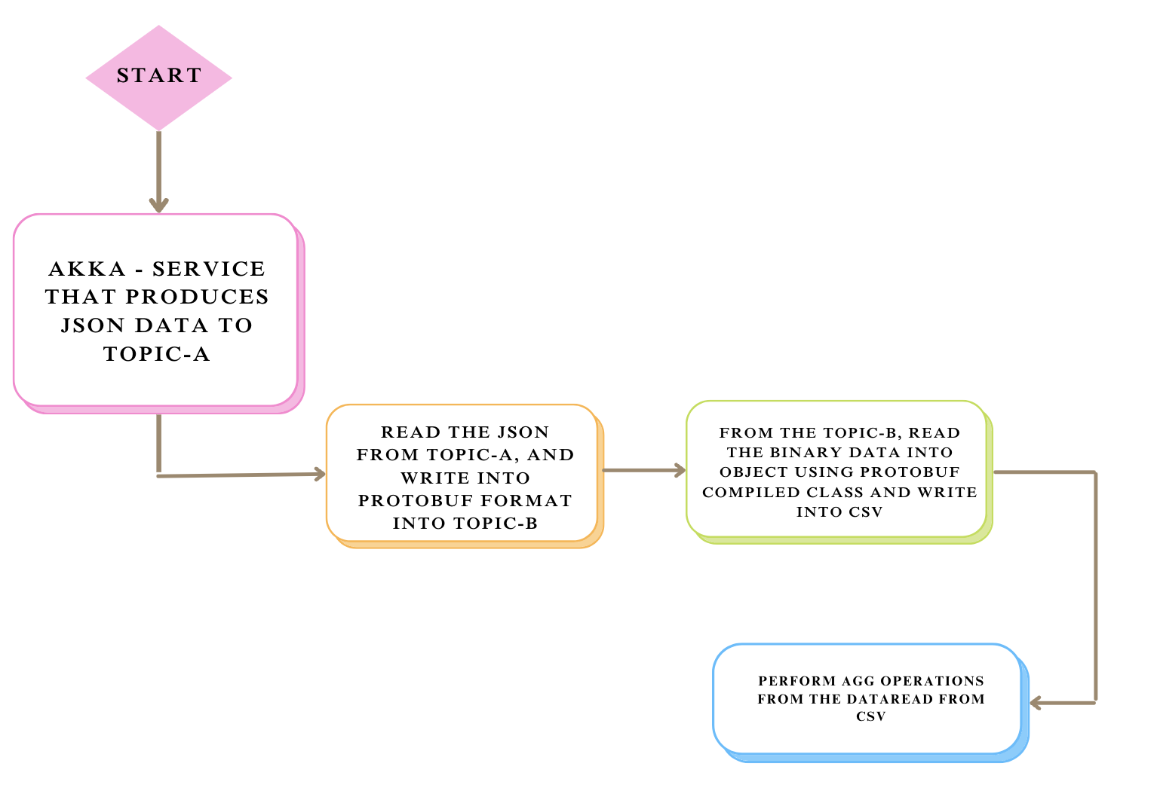
Flow Diagram

Slide 7
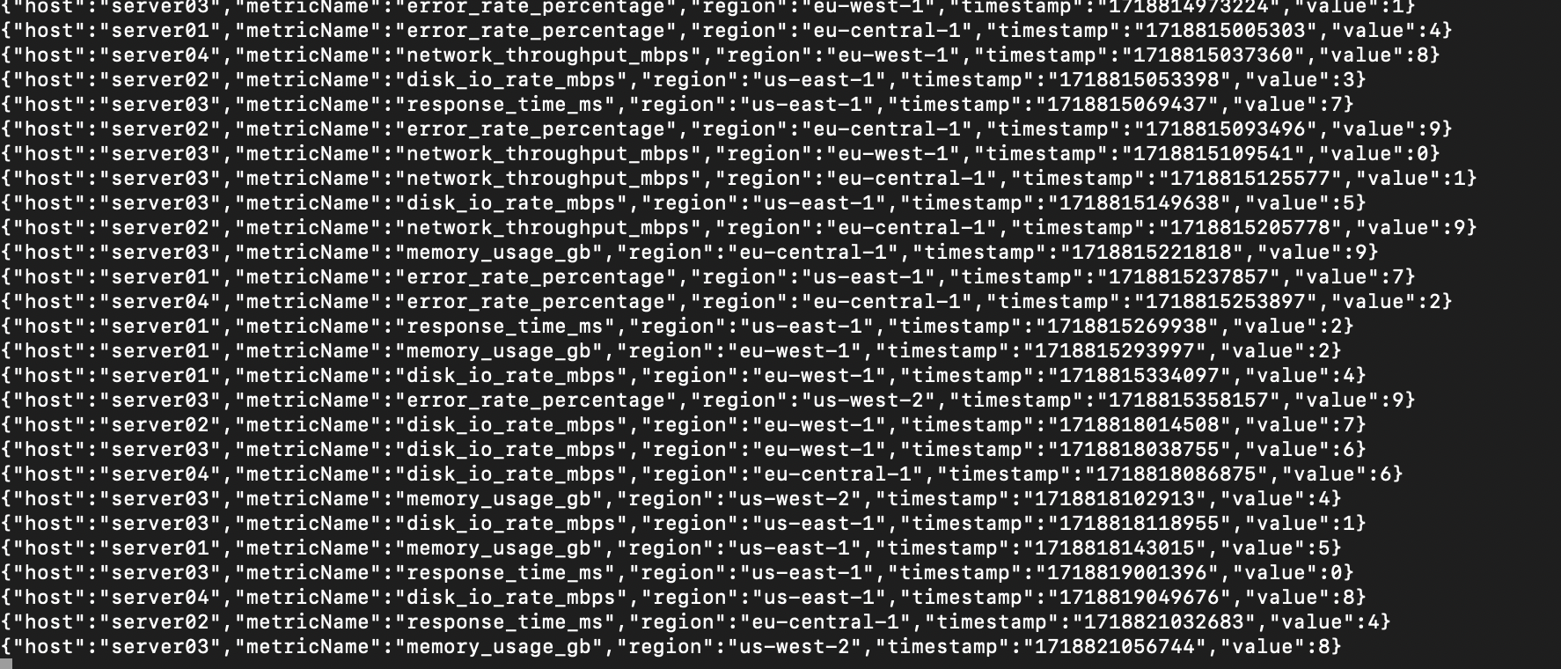
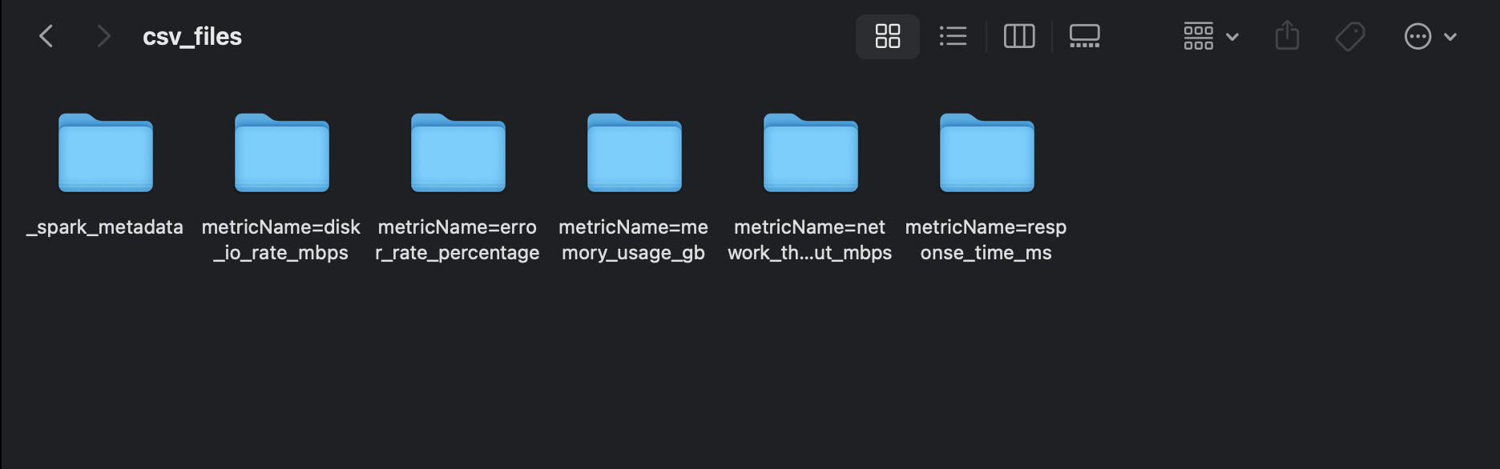
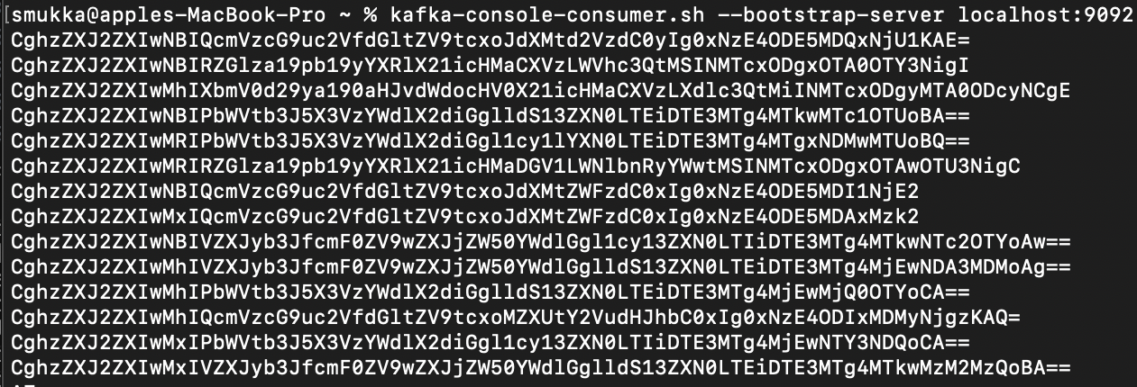
Mandatory Case - 2

Slide 8
Mandatory Case - 3
Executing Jobs on EMR
Create a EMR Cluster and configure it.
Create EMR Studio and create a notebook setup.
Write a spark Job on EMR Notebook to read all the files from the given dataset convert it into parquet format and write it to another AWS s3 bucket.
Create at least 10 different Spark Jobs to perform various filtering , aggregation and selection operations on the data set that is in parquet format.
Store the results of each consolidation in MySQL database table.

Slide 9
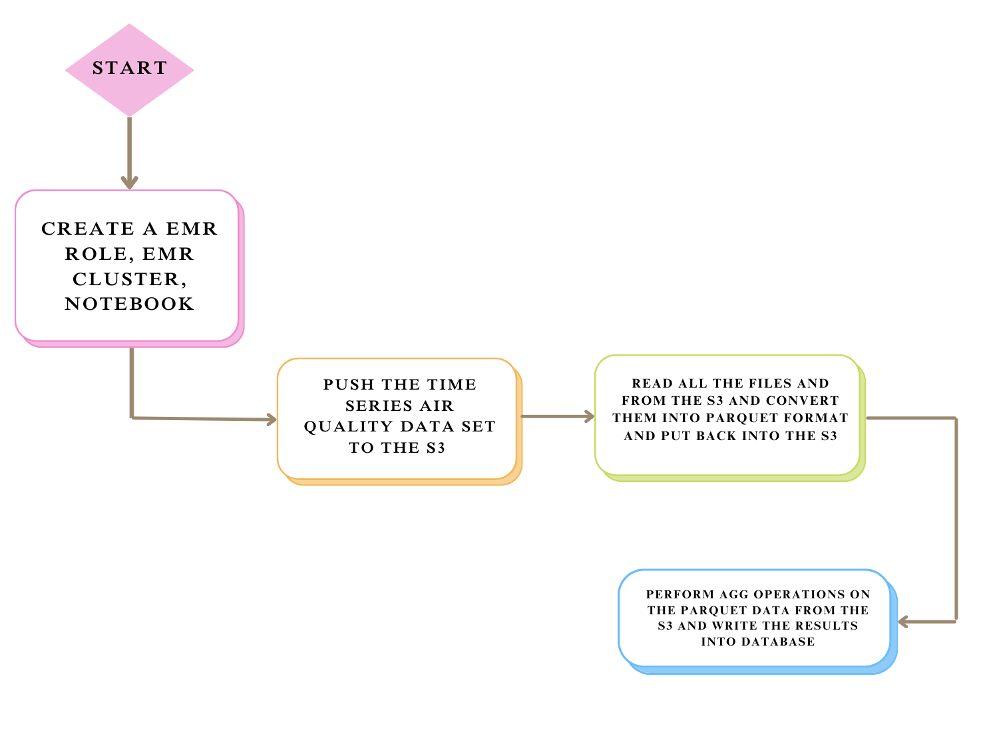
Flow Diagram

Slide 10
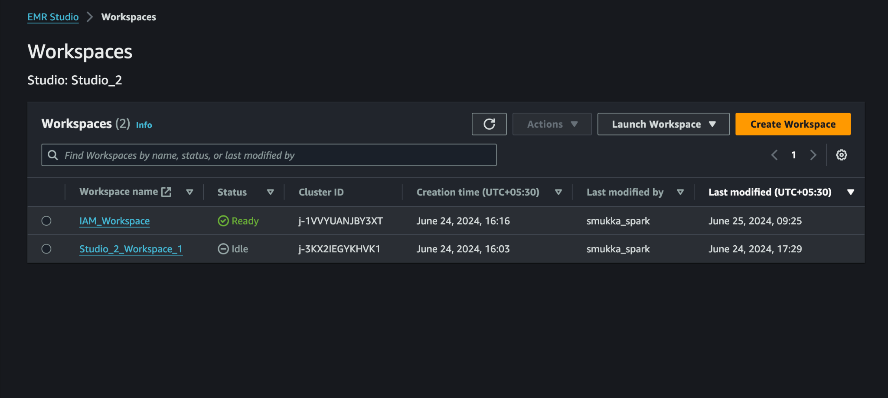
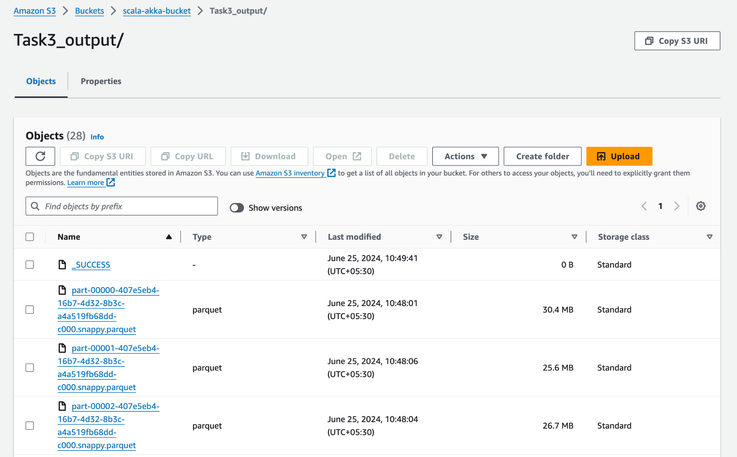
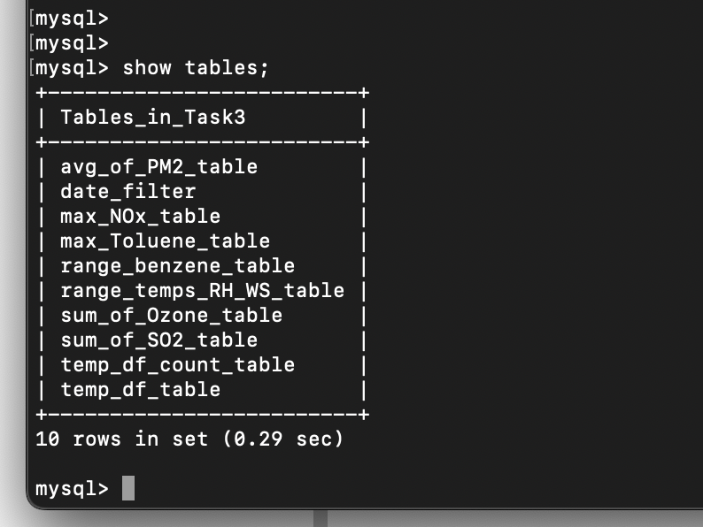
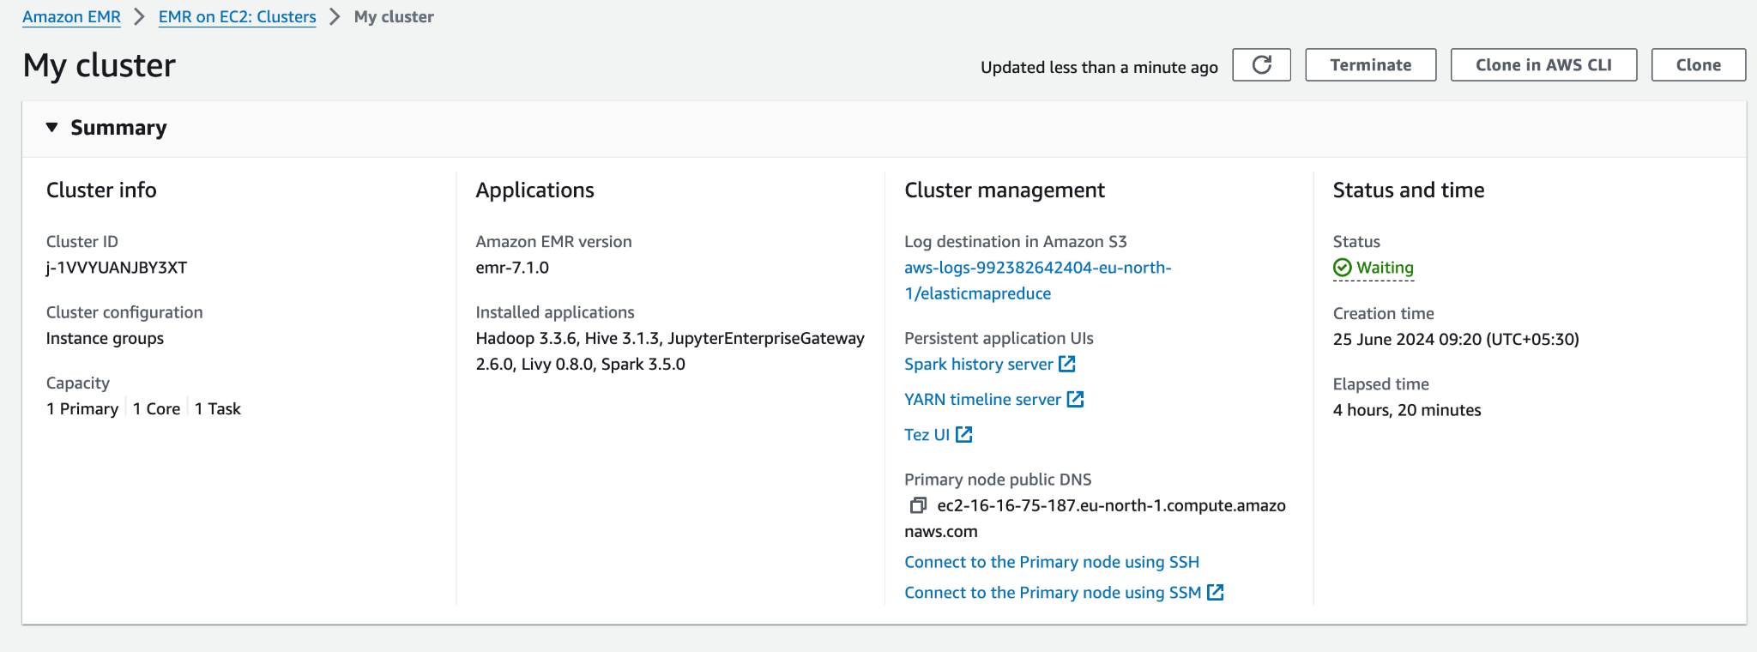
Mandatory Case - 3

Slide 11
Optional Scenario - 3
Come up with your own Dataset that has two different input datasets and implement the concept of broadcasting.
Solve the problem of joining two datasets and performing aggregate operations:
1. Do the Task without Broadcasting
2. Do with broadcasting
Done with:
1. Group By
2. Window and partition By

Slide 12
Broadcasting in Spark
Broadcast variables are an essential component of distributed computing frameworks, such as Apache Spark and Apache Flink. They serve as a mechanism to efficiently share immutable data structures across a cluster of machines, minimizing the need for redundant data transfers.

Slide 13
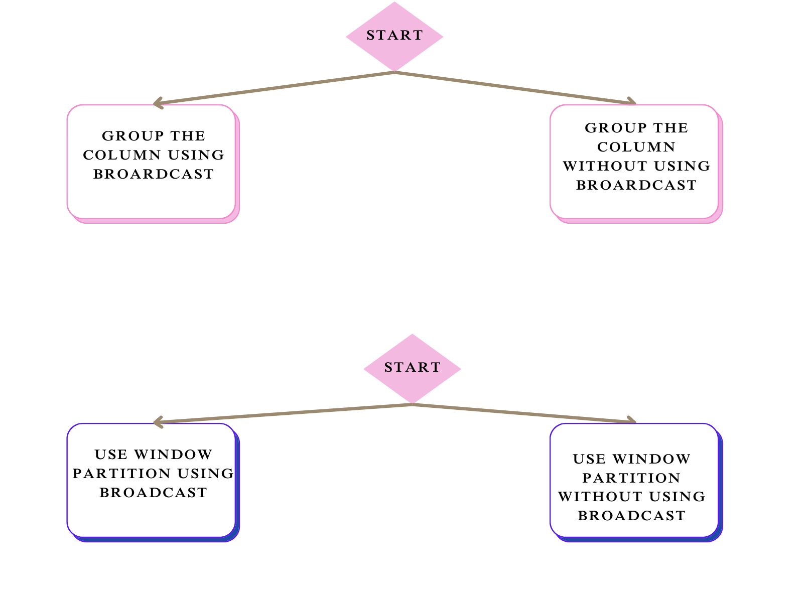
Flow Diagram

Slide 14
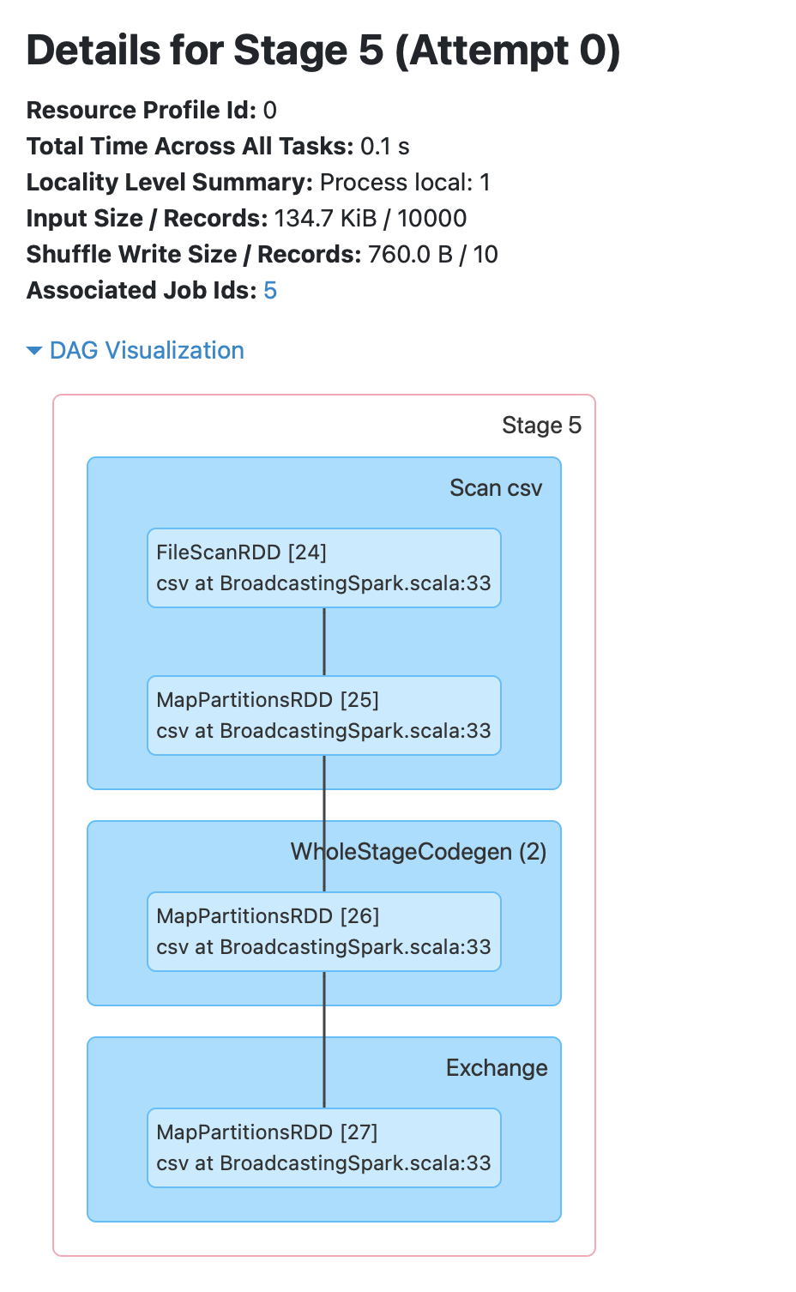
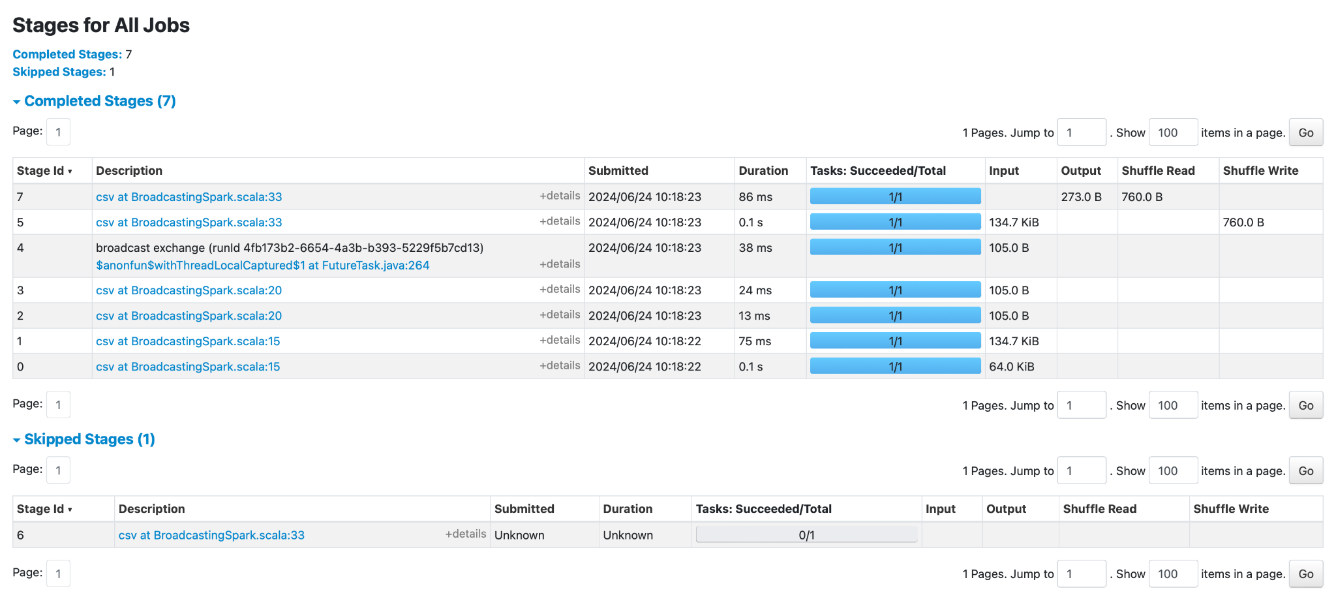
With Group By
Group-By without Partition
Time Taken : [info] Time without broadcast: 0.024850625 seconds

Slide 15
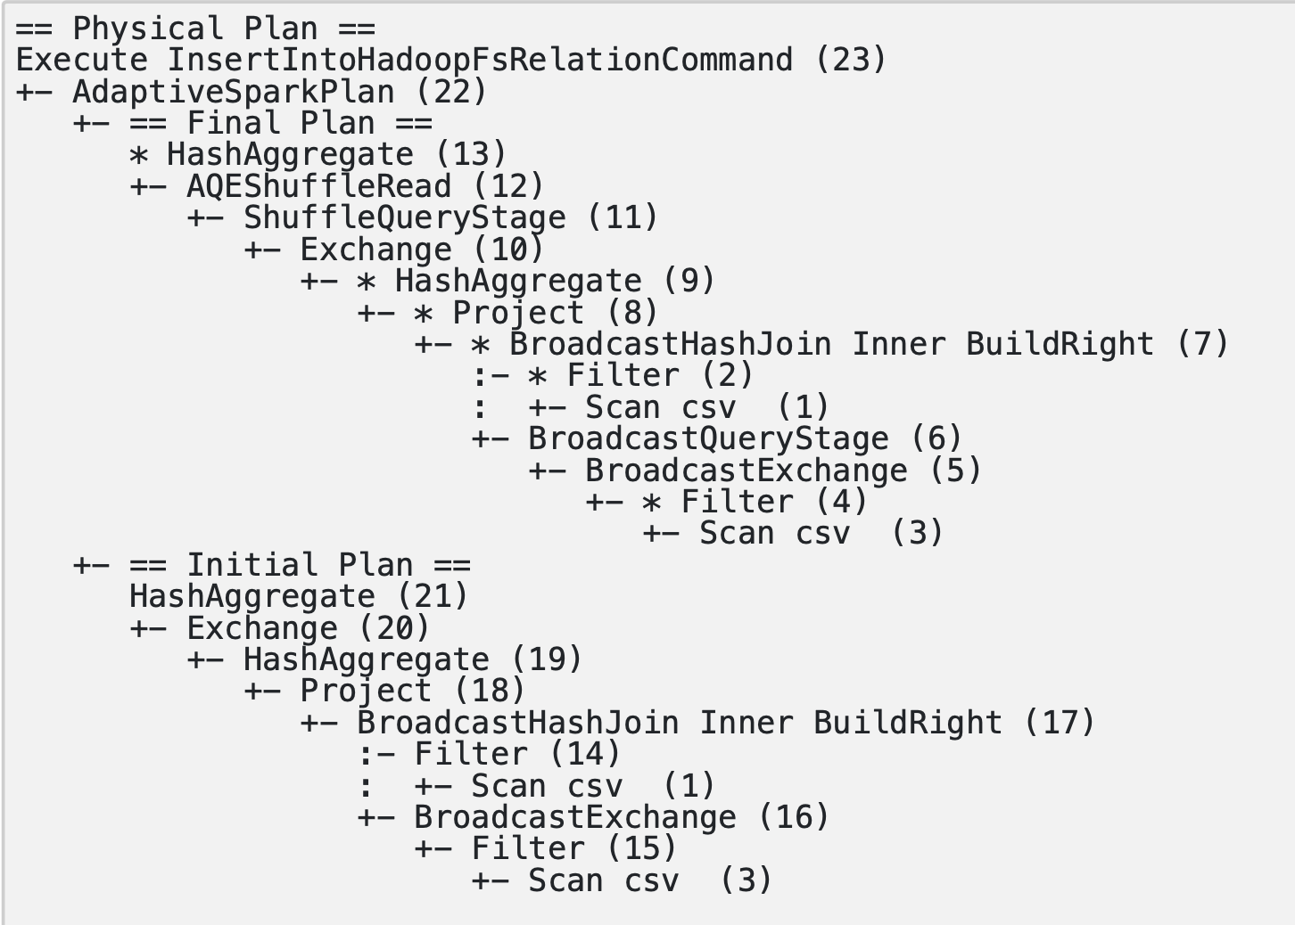
With Group By
Group-By with Broadcasting
Time Taken: [info] Time with broadcast: 0.026601667 seconds

Slide 16
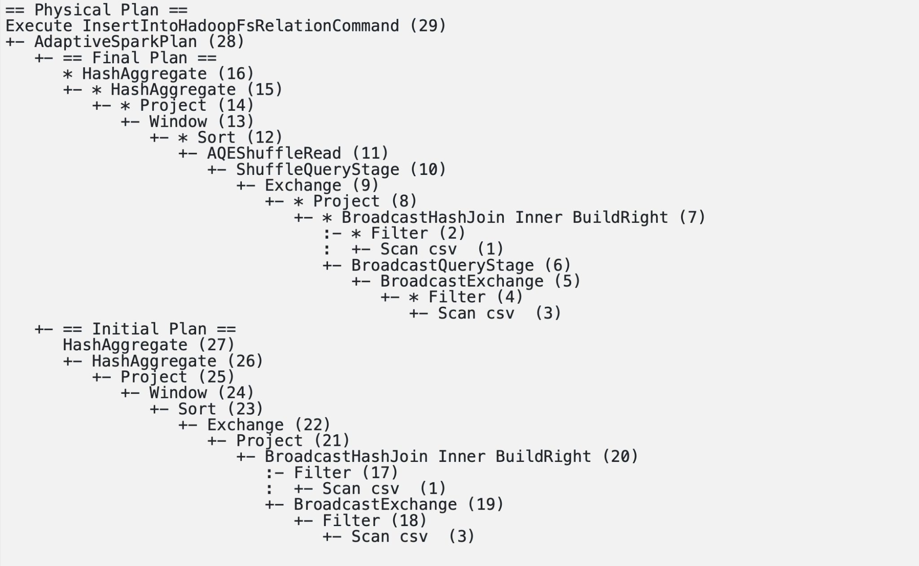
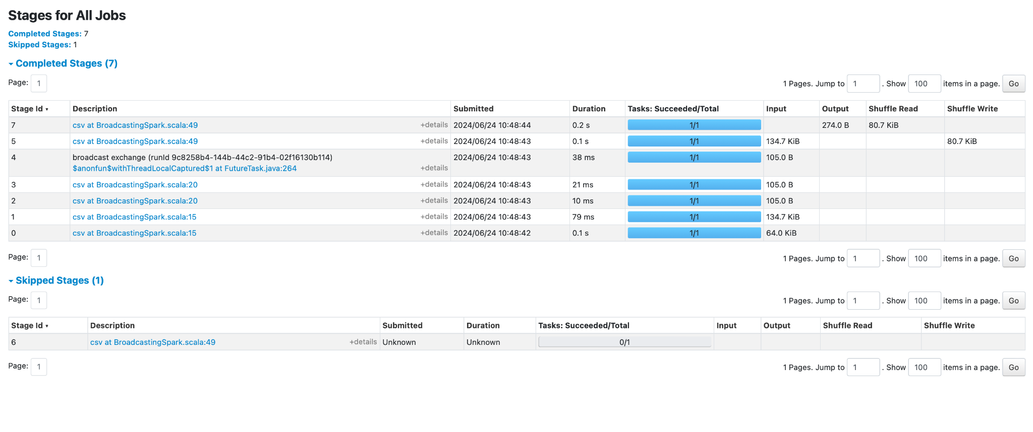
With Window partition
​With window partition without broadcast
​​Time Taken: [info] Time with window partitioning and no broadcast: 0.023458625 seconds

Slide 17
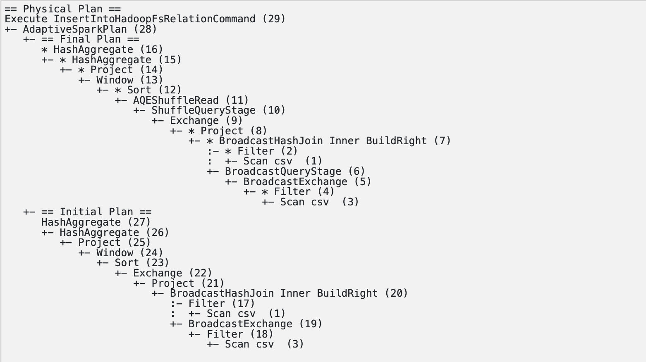
With Window partition
With window partition with Broadcasting
Time Taken: [info] Time with window partitioning with broadcast: 0.019966125 seconds

Slide 18
Optional Scenario - 4
There are many Cases Caching that can make the processing better and reduce the
overall processing time.
• Come with a Scenario where you can implement Caching and persistence if needed
and do the scenario without Caching and persistence
• Check the performance differences

Slide 19
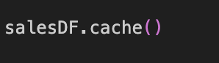
Cache
When you invoke the cache() method on an RDD or DataFrame, it stores the data in memory after the first time it is computed. This keeps the data readily available for future actions without the need to recompute it.

Slide 20
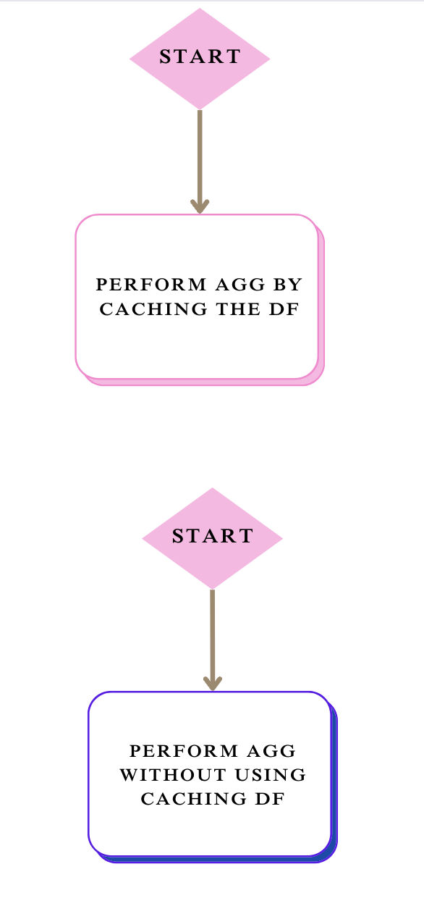
Flow Diagram

Slide 21
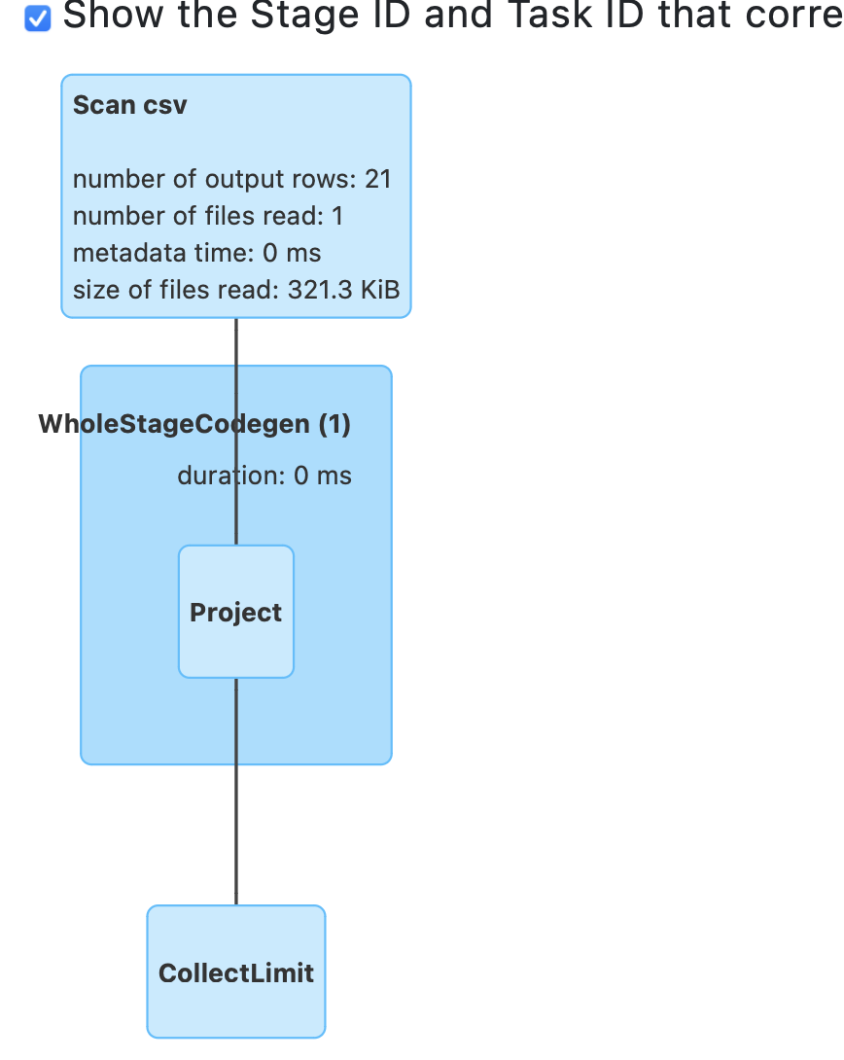
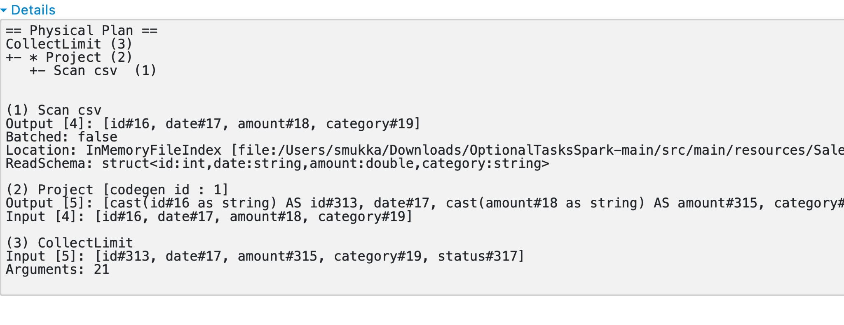
Cache
Without Caching

Slide 22
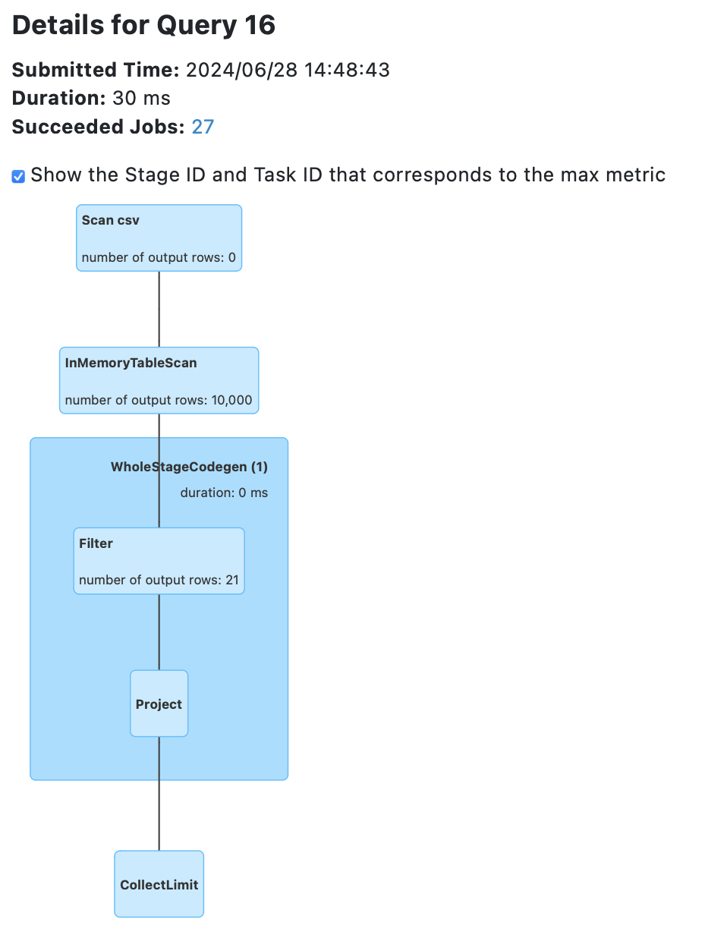
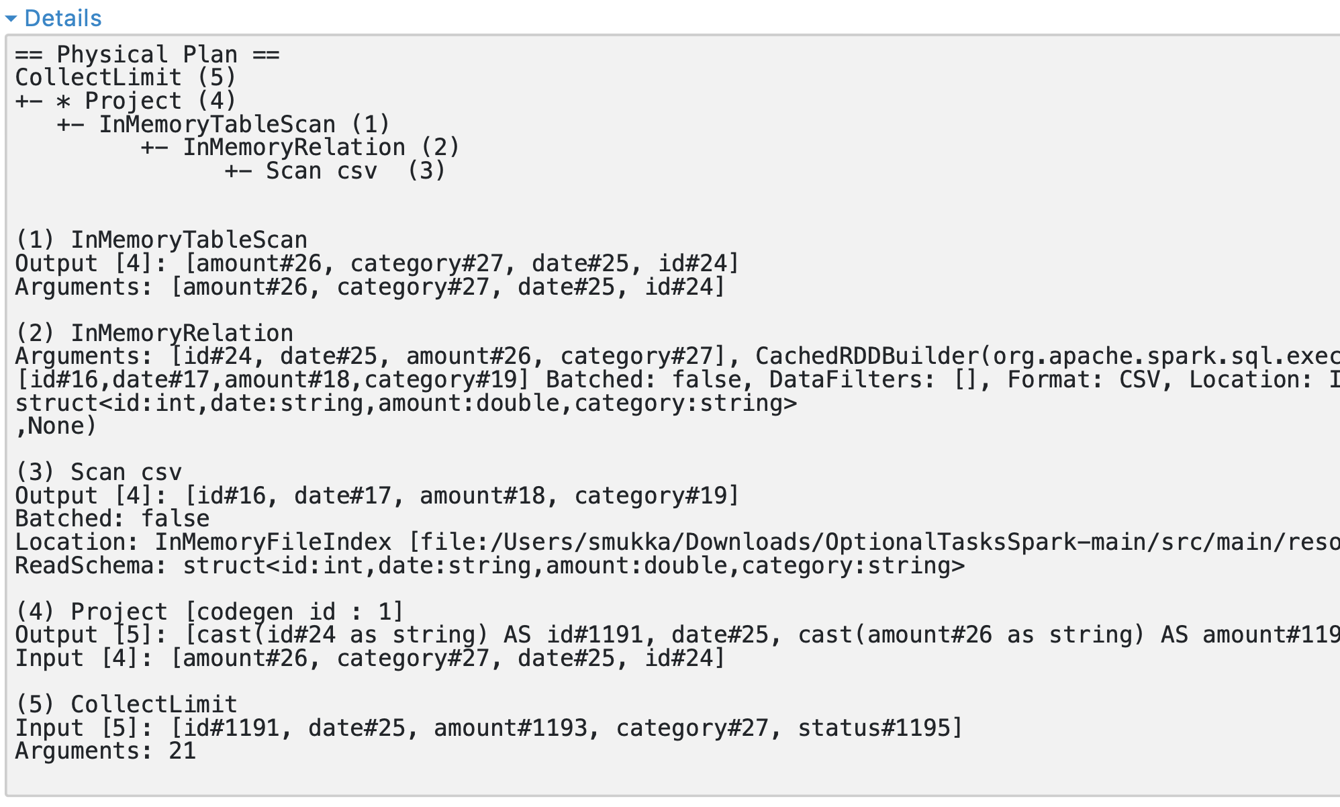
Cache
With Caching

Slide 23
Thank you

